Slide 1

Consumer Goods Ad – Hoc Insights

Slide 2
Company Overview
AtliQ Hardwares
Overview: AtliQ Hardwares is a leading computer hardware manufacturer based in India, with a strong market presence extending to several other countries.
Industry Leadership: The company is recognized as one of the major players in the computer hardware industry, known for its innovation, quality products, and expansive distribution network.

Slide 3
Problem Statement
The company has received 10 ad-hoc requests from various departments, all requiring detailed insights to address specific business questions. These requests range from sales performance analysis to product distribution efficiency.

Slide 4
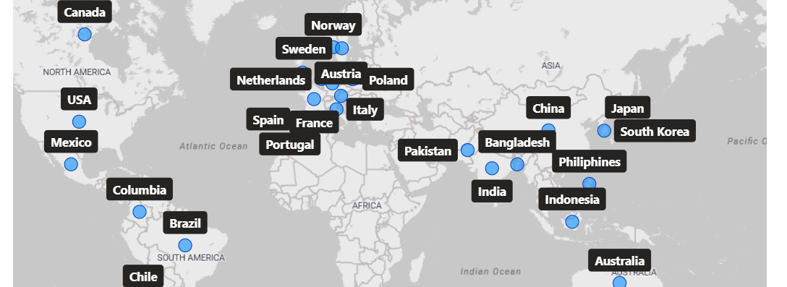
AtliQ Markets

Slide 5
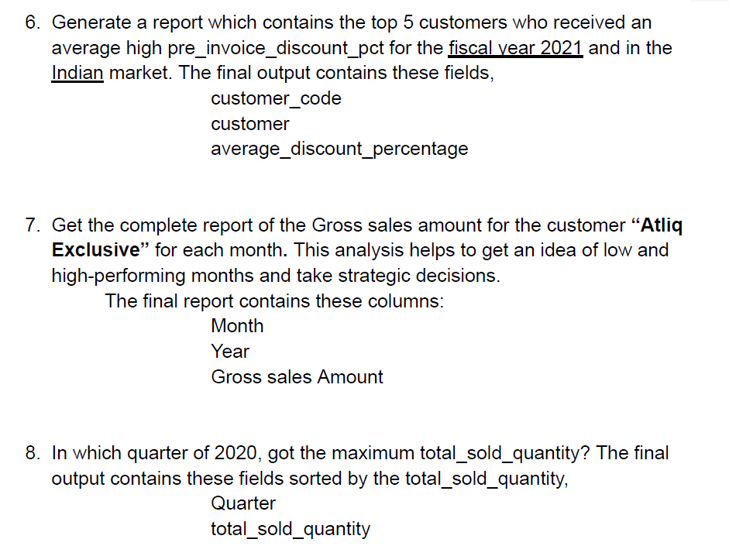
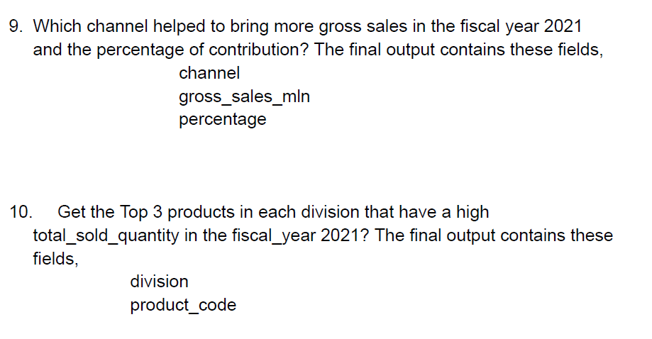
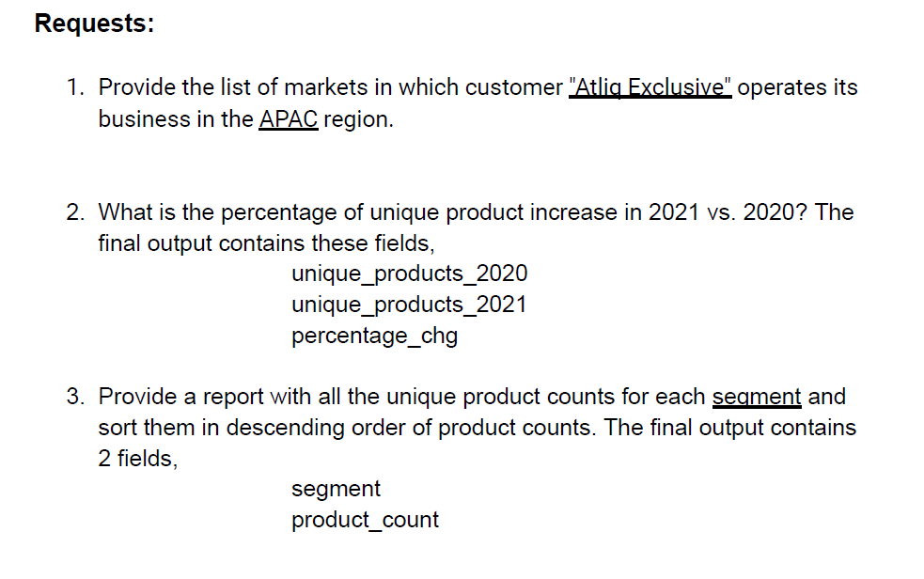
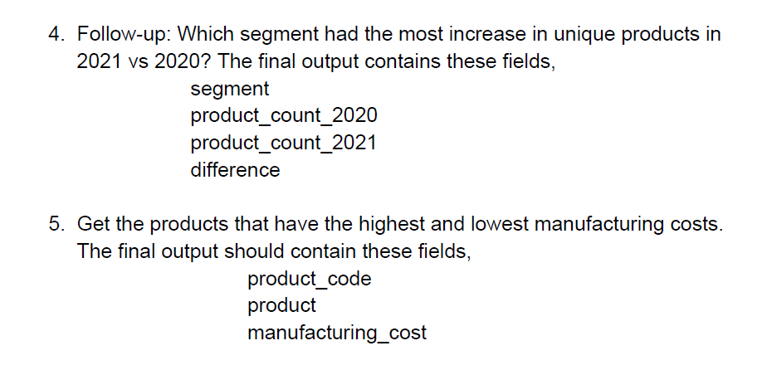
Consumer Ad – Hoc Requests

Slide 6

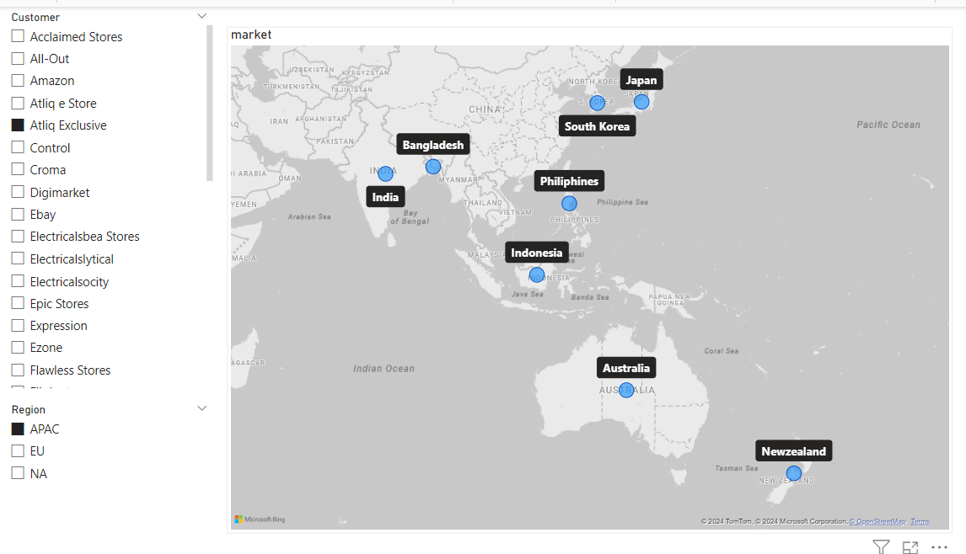
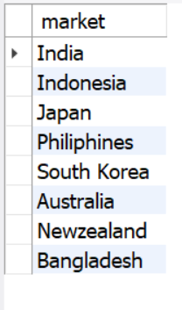

Slide 7


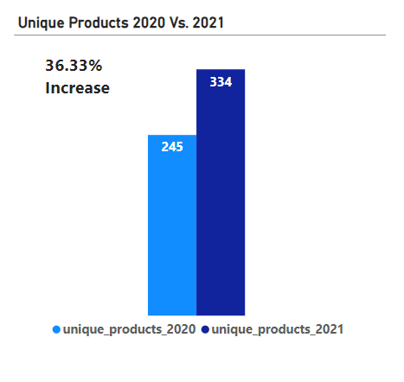

Slide 8

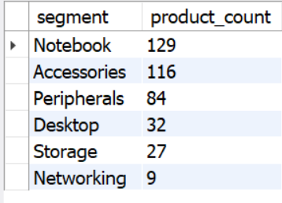
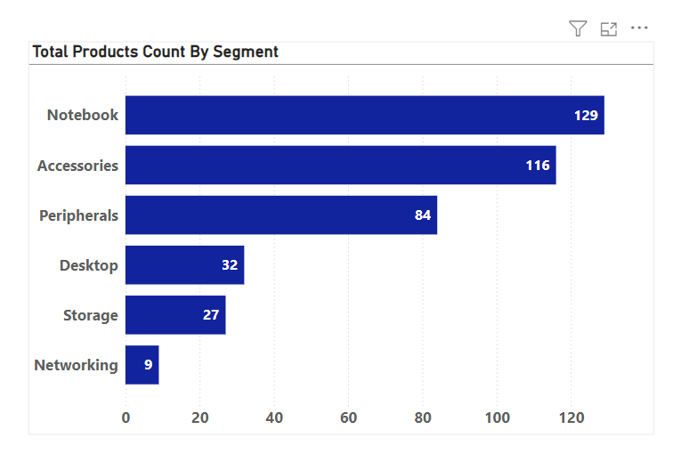

Slide 9

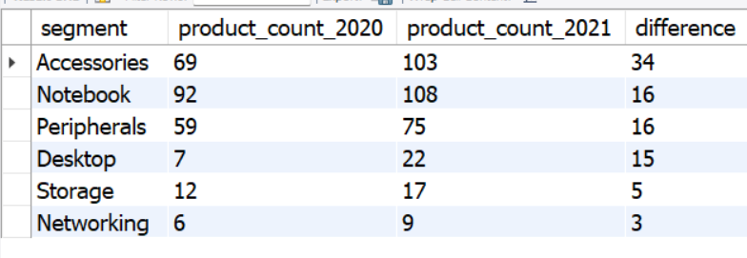
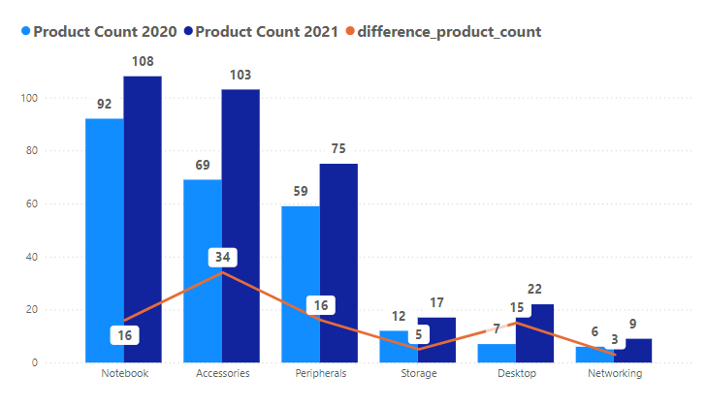

Slide 10


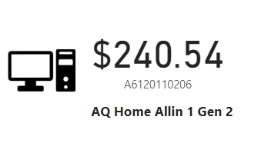
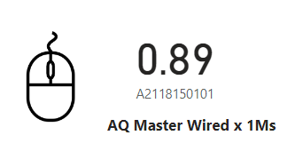
Personal Desktop
Mouse

Slide 11

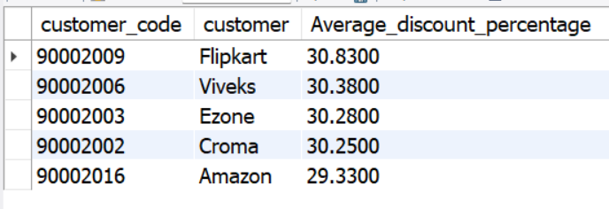
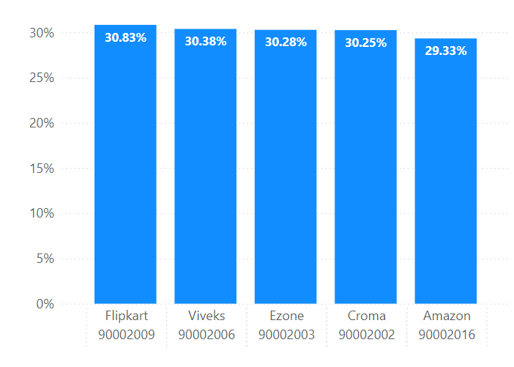

Slide 12

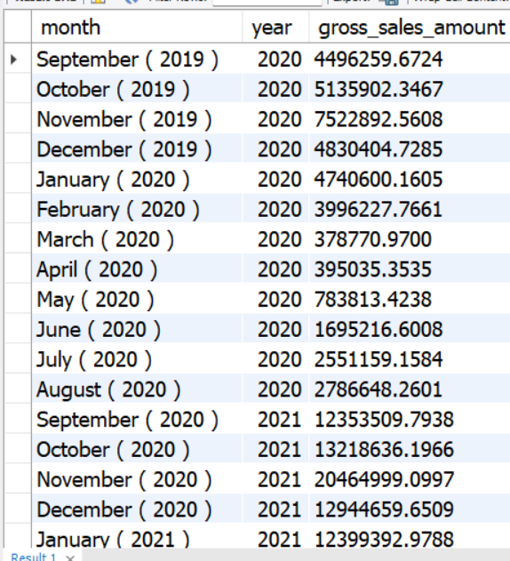
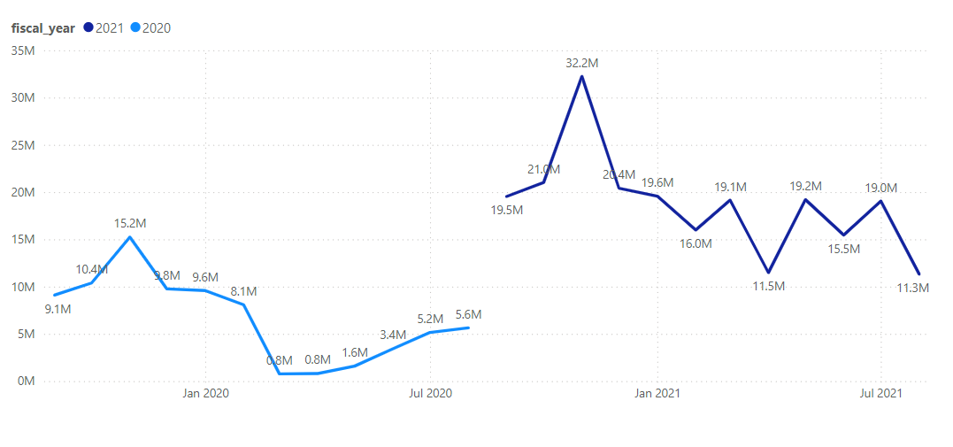

Slide 13

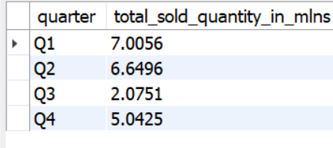
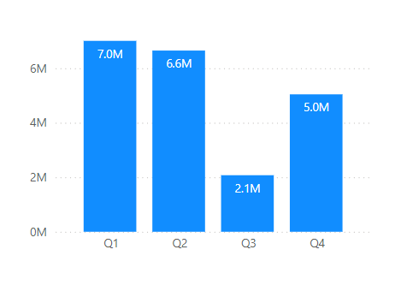

Slide 14


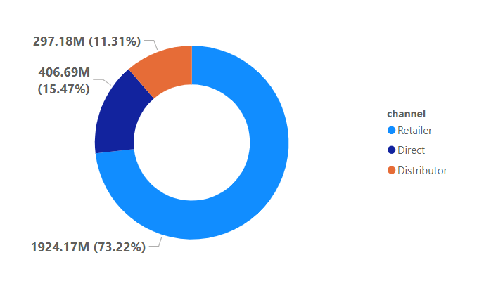

Slide 15


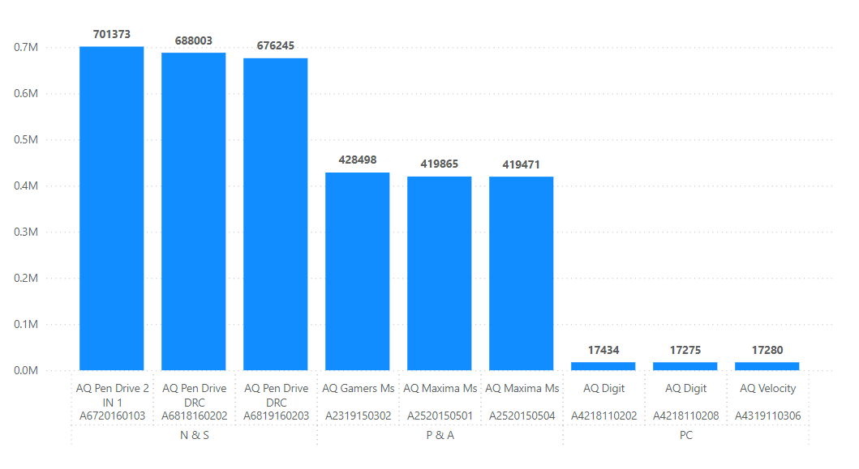
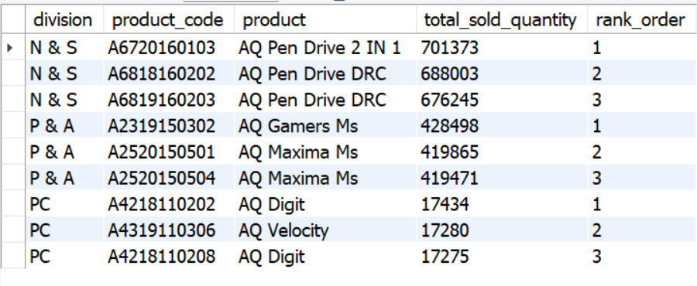

Slide 16
Thank You
Email : devraj.muni143@gmail.com Mob : 7064649974

